Slide 1
SAP Process Integration
2
Application Environment
System Landscape Directory

Slide 2
System Landscape Directory Overview
Central information provider for NetWeaver system landscapes
Manage software components and platform dependencies
Facilitate Installations, upgrades and transports
Based on Common Information Model (CIM) of the Distributed Management Task Force (DMTF)
Basis for SAP Solution Manager
Information provider for SAP PI
Notes:
The System Landscape Directory is a central repository of information about software and systems in the data center, expressed in a standard schema called the Common Information Model, or CIM.
CIM was developed by the Distributed Management Task Force, or DMTF, an industry consortium whose goal is to enable management of IT systems in distributed environments using web standards.
For more information, see www.dmtf.org.

Slide 3
Fundamental SLD Concepts
A landscape contains information regarding different types of systems such as AS ABAP systems, AS Java systems and third party systems. The Data Suppliers of the SLD collect the data about these systems and send this data to the SLD.
In order to receive automatically reported data from the data suppliers that run on the individual systems, they must be registered on the SLD.
For this purpose, the SLD bridge has to be configured and started.
The SLD bridge transforms the system data sent by data suppliers to the SLD server into CIM-compliant format. The SLD bridge then forwards the data to the SLD server.

Slide 4
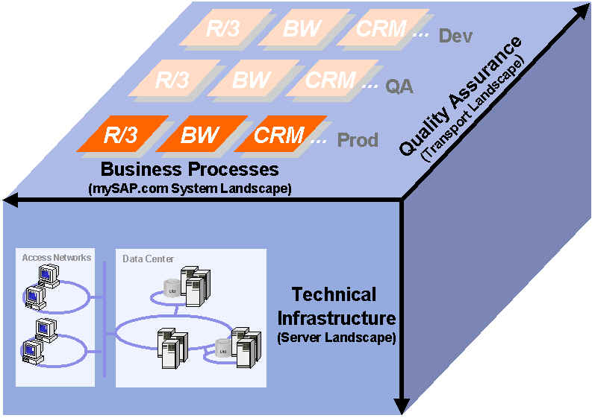
Aspects of system landscapes
Notes:
System Landscapes have 3 dimensions: the solution dimension (i.e., what software processes are installed), the transport dimension (DEV, QAS, and PRD, for instance), and the technical dimension (what products are installed on which hosts on particular networks).
The SLD should capture all three dimensions of the System Landscape.

Slide 5
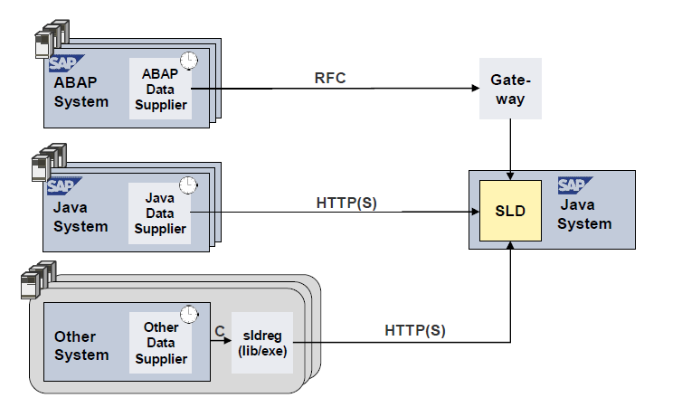
How Does SLD Get Landscape Description Data?
Data suppliers collect and send data of systems to SLD
Must be set up once per landscape element After that, they send reliable and up-to-date data automatically
Periodical reporting (batch job)

Slide 6
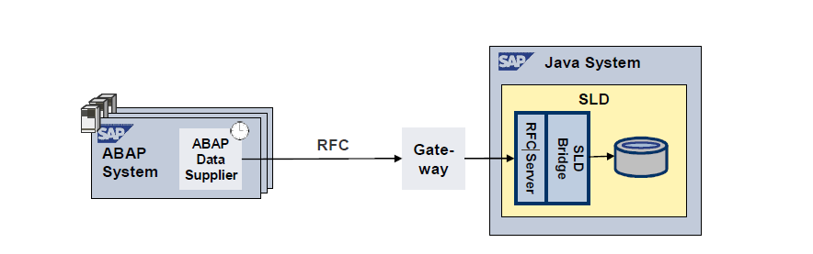
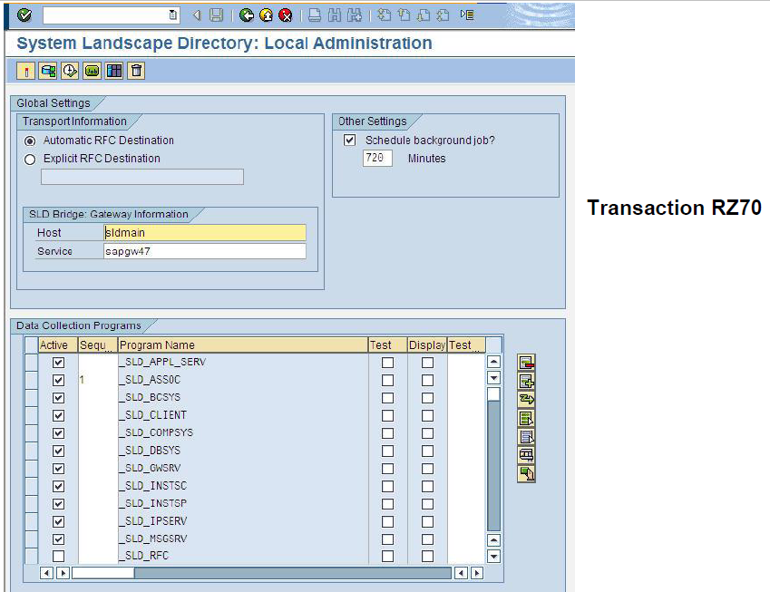
Data Supplier – ABAP-based Systems
Architecture of data supplier for ABAP-based systems:
The data supplier within an ABAP-based system periodically delivers collected system information to SAP Gateway (required additionally)
SAP Gateway routes information to SLD bridge (part of SLD)
SLD bridge transfers this information (as CIM-compliant data) to SLD
Data suppliers are available for ABAP-based systems as of release 4.0B(SAP_BASIS/SAP_ABA)

Slide 7
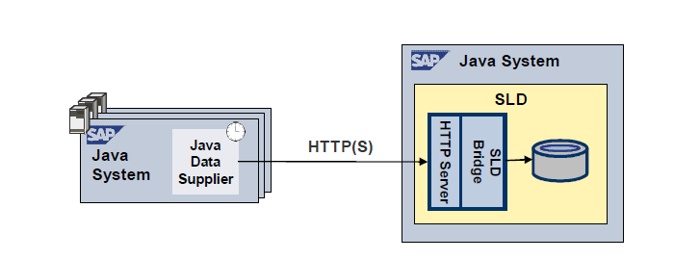
Data Supplier – Java-based Systems
Architecture of data supplier for Java-based systems:
SLD bridge (part of SLD) serves as an HTTP servlet which receives system data reported by Java data suppliers and forwards them to SLD.
Data suppliers are available for Java-based systems as of
SAP Web Application Server Java 6.30

Slide 8
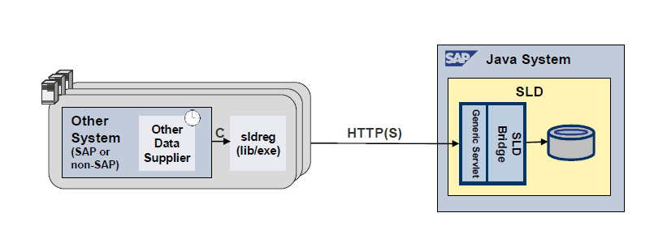
Data Supplier – SLDREG
Architecture of data supplier for non-ABAP, non-Java-based systems:
SLDREG, available as of SAP NetWeaver 7.0
Can be used for SAP (such as TREX) or non-SAP components

Slide 9
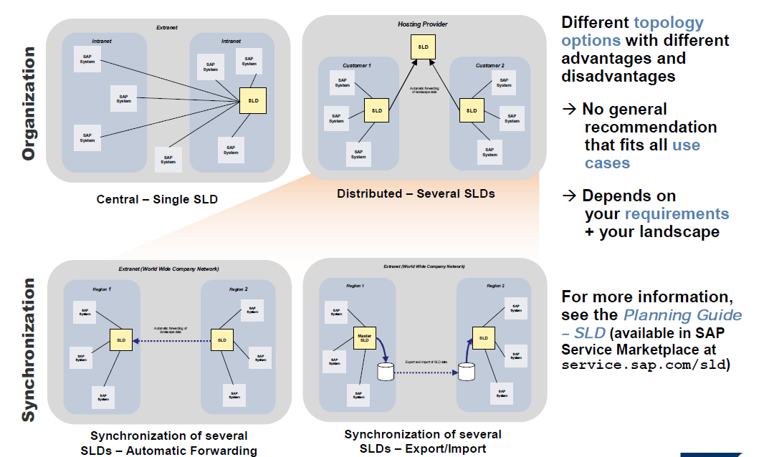
Your SLD Topology – A question of Your Requirements

Slide 10
SLD content type
Component Information
Describes building blocks of solutions
Describes possible combinations and dependencies
Delivered by SAP, extensible by customer
Landscape Description
Information on installed landscape elements
Customer-specific
SAP PI utilizes both types of content for:
Enterprise Service Builder: Component Information
Integration Directory: Landscape Description
Notes:
There are two main areas of content in the SLD: the software catalog, and the systems catalog.
The Software catalog describes the installed products and their constituent components. The software catalog is delivered with content about all SAP products. Customers and Partners can extend this catalog with information about software from other vendors.
The Systems catalog describes the systems in the data center from two perspectives: a logical view (business systems) and a physical view (technical systems). In other words, the Systems catalog describes the concrete implementation of the customer landscape.
Information from the software catalog is used in the Integration Repository to organize development efforts. Information from the systems catalog is used in the Integration Directory to drive the specific configuration of Integration scenarios.

Slide 11
SLD: Products and Software Components
Product
Software Component
0..1
0..1
*
*
Product Version
Software Component Version
1
*
*
Software Feature
*
Notes:
A Software Product (such as SAP R/3) may exist in multiple versions (such as 4.6c, 4.6d, 4.7 .
A Software Component is a unit of software delivery that has its own support package track. Example of Software Components are SAP_APPL, SAP_ABA, SAP_HR, etc.
A Software Product is composed of one or more software components. For instance, the product R/3 version 4.6C has components:
SAP BASIS
SAP APPL
SAP ABA
SAP HR
SAP GUI
The relationship between a software product and its constituent components is described in the SLD by an association called a Software Feature.

Slide 12
Example: SAP APO
Notes:
An example of the relationship between software product version and its components: SAP APO v. 3.1.

Slide 13
SLD: Technical System
Technical System
WebAS ABAP
Name; host name; system number; Release
Installed clients
Business System
Message Server
Installed Products
WebAS Java
Name; host name; SID; System Home
Standalone JAVA
Technical System ID
Business Systems
Third Party
Business Systems
Installed Products
Notes:
In the Systems Catalog we define each Technical System in the landscape. The exact settings for each System depend on the system type.
Technical systems are the basis for defining Business Systems. The association between the Technical system and the Business Ssytem is dependent on the TS type; for instance, in a system based on SAP Web AS (ABAP), each client in the system is a separate Business System (this corresponds to the notion of a client as a Logical System in ALE configuration).

Slide 14
SLD: Business System
Business System
WebAS ABAP
Related Integration Server
client
Technical System
Installed Products
WebAS Java
Related Integration Server
Name
Technical System
Third Party Systems
Technical System
Related Integration Server
Installed Products
Standalone Java
Name
Technical System
Notes:
The Business System definition points to the appropriate Technical System. The SLD makes the appropriate association.

Slide 15
SLD and XI Integration Repository
Integration Repository (Design)
Software Component Version
Business Scenario
Application Component
Role
Product Version
System Landscape Directory
Mapping Objects
Product
Product Version
Interface Objects
Software Component
Software Component Version
Notes:
All design work in the Integration Repository is organized by Software Component Version. This makes sense, as interfaces logically belong to a software component and to a particular version. For instance, a BOMMAT03 IDOC is used by SAP systems from version 4.0 on, but a BOMMAT05 IDOC is used by SAP systems from 4.7 on. And, more specifically, the IDOC specifically belongs to the software component SAP APPL (which is why a BOMMAT IDOC does not exist in a Web AS with no application layer).
Before development can begin, the Software Component Versions (SWCV’s) ust be imported from the SLD to the Integration Repository.
Additionally, when we design business scenarios in the Integration Repository, the Application Components that we assign in the scenario editor are assigned from Product Versions in the SLD.

Slide 16
SLD and Repository: usage dependencies
SAP Integration Builder Repository (Design)
A dependency can be defined in the SLD
This dependency will be automatically detected in the Integration Repository
Software Component Version A
...
Basis objects
System Landscape Directory
X
Software Component Version A
Software Component Version B
Software Component Version B
Usage Dependency
X

Slide 17
SLD and Directory
SAP Integration Directory (Configuration)
Routing Relations
Sender Service:
Business System
Receiver Service:
Business System
System Landscape Directory
A service object in the Integration Directory can be derived from the SLD.
Business System
Technical System
Notes:
Routing Relations in the Integration Directory point to the Business Systems that are maintained in the System Catalog of the SLD, and through the appropriate association, to the technical systems.

Slide 18
Summary: object structure in SLD
Notes:
To summarize: Products are collections of Software Components; both Software Products and Components exist in versions.
Products are installed on Technical Systems, which describe the concrete structure of Systems in the Data Center.
Applications communicate with Business Systems, which provide a logical view of the system that participate in a particular Integration Scenario.

Slide 19
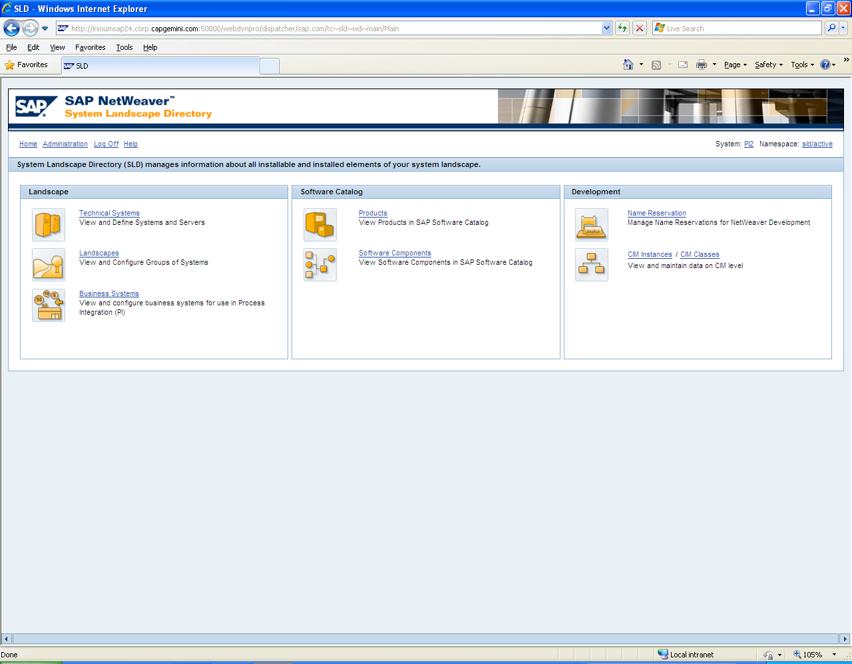
SLD Screen overview

Slide 20
SAP Exchange Infrastructure
Introduction
1
2
Application Environment
3
Demonstration
4
Hands On
5
HelpMe

Slide 21
System Landscape Directory Demo
SLD Demo

